Slide 1
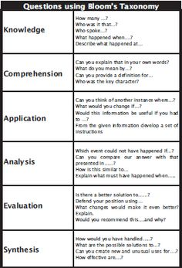
Do Now: 26.2.16 Topic: The Romantic Era 1770-1837(-ish)
READ:
the knowledge organiser that you’ve been given.
CREATE:
one question for the group to DISCUSS.
Write it on your place mat.

Slide 2
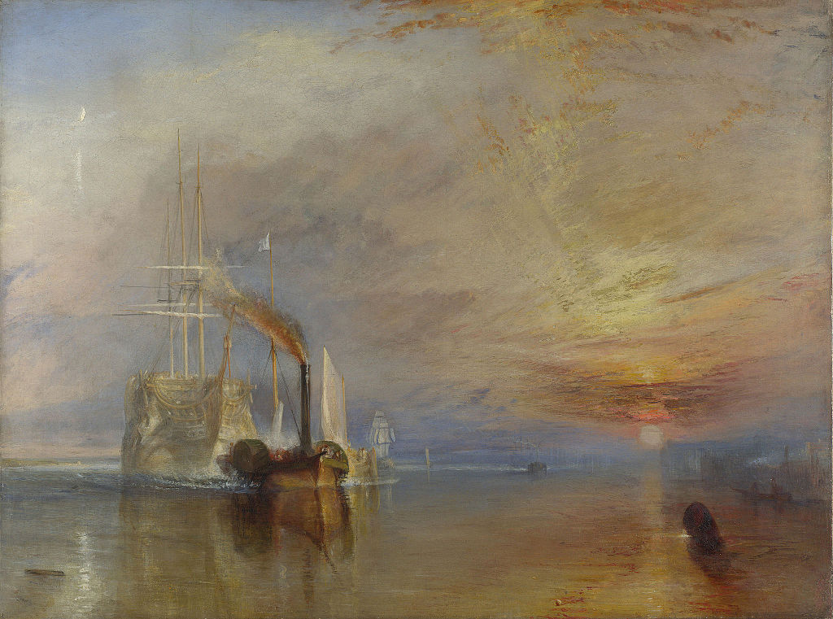
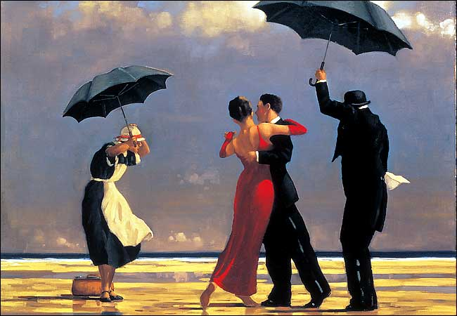
Romantic not (necessarily) romantic
‘The Fighting Temeraire’
JMW Turner, 1839
‘The Singing Butler’
Jack Vetriano, 1992

Slide 3
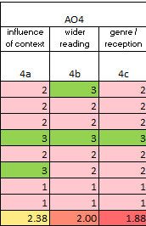
So Why?
Candidates characteristically:
a) use their mature understanding of the relationships between literary texts and their contexts to illuminate readings of the items
b) develop relevant wider reading links that are sophisticated and enrich the candidate’s response to the items
c) evaluate the influence of culture, text type, literary genre or historical period on the ways in which literary texts were written and were – and are – received.

Slide 4
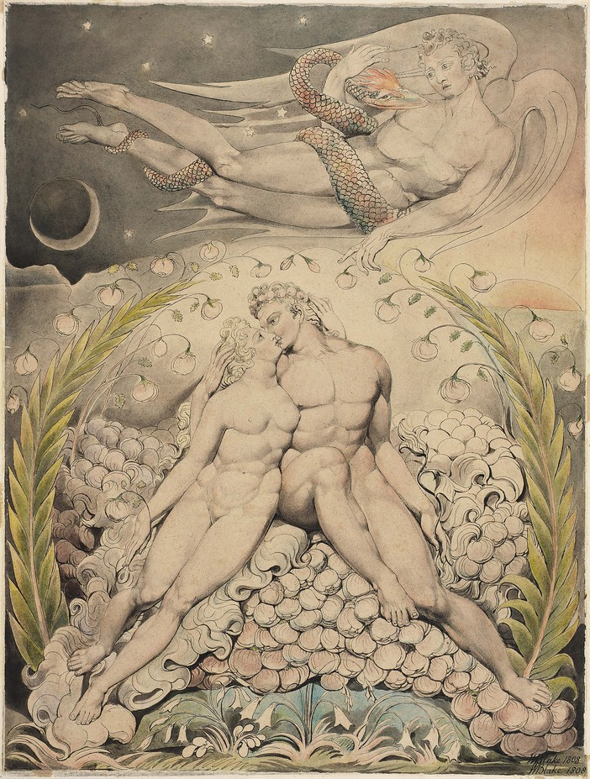
William Blake, ‘Satan Watching the Endearments of Adam and Eve’, 1808

Slide 5
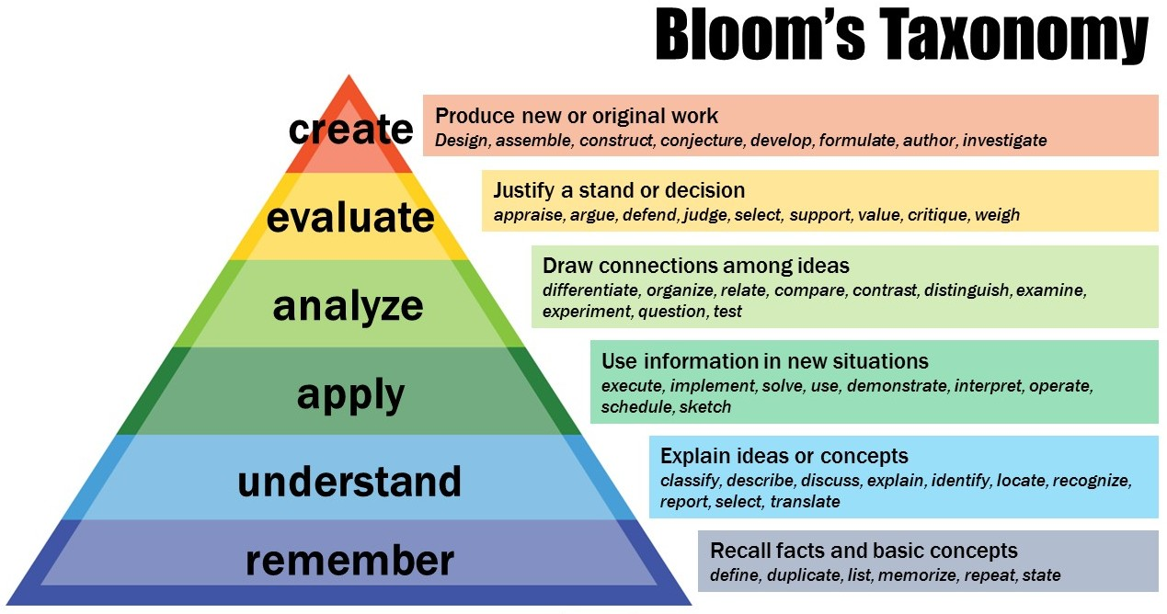
https://www.youtube.com/watch?v=V7M_EyImb-g

Slide 6
Recall Quiz
Can you name one Robert Burns poem?
Which happened first, the French Revolution or the signing of the US Constitution?
What is the difference between Romanticism and romance?
‘I wandered lonely as a’ what?
Name the two key women writers.
FINISHED?
Why might it be that only two women stand out as key literary figures?

Slide 7
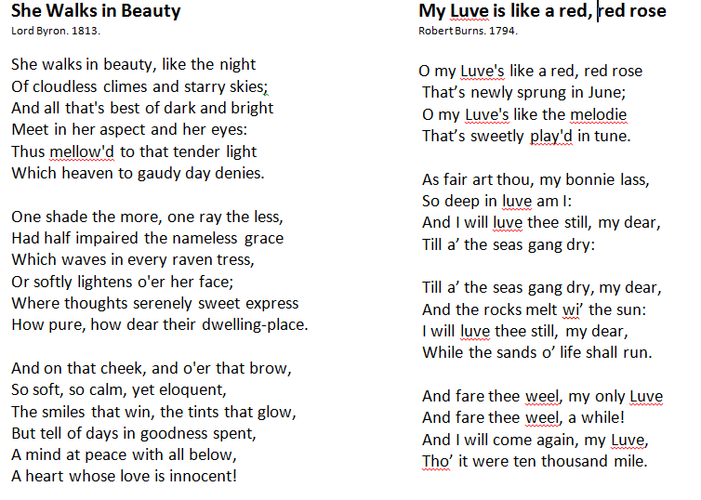
While you listen, let your pen dawdle over the page.
What words and associations are you coming up with?

Slide 8
Building Questions
Byron
IDENTIFY-APPLY:
How many references to nature are there?
How might these be typical of the period?
DEFINE-EVALUATE: What does ‘innocent’ denote and connote?
What events in the timeline might this link to?
Burns
IDENTIFY-APPLY:
How many references to nature are there?
How might these be typical of the period?
ANALYSE-EVALUATE:
What is the shift in the first stanza?
What might this tell us about the period?

Slide 9
COMPARE-EVALUATE
How are the women presented in the poems? What might this tell us about the period?
Which poem do you prefer? Why?
FORM: Two-sentence answers are required here. The first should be simple and the second complex.

Slide 10
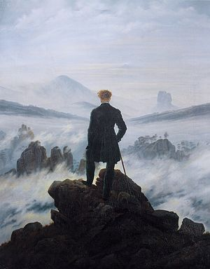
David Friedrich Caspar ‘Wanderer Above the Sea of Fog’, 1818

Slide 11
Writing Task
Choose one of these poems as Text 1.
Jane Eyre is Text 2.
Plan a comparison between the two:
Which bit of the novel might you choose?
What might be a relevant context in which to consider the two texts?
Which wider reading will you include?
Write a short summary of the argument you will make.
5 MINUTES
5 MINUTES

Slide 12
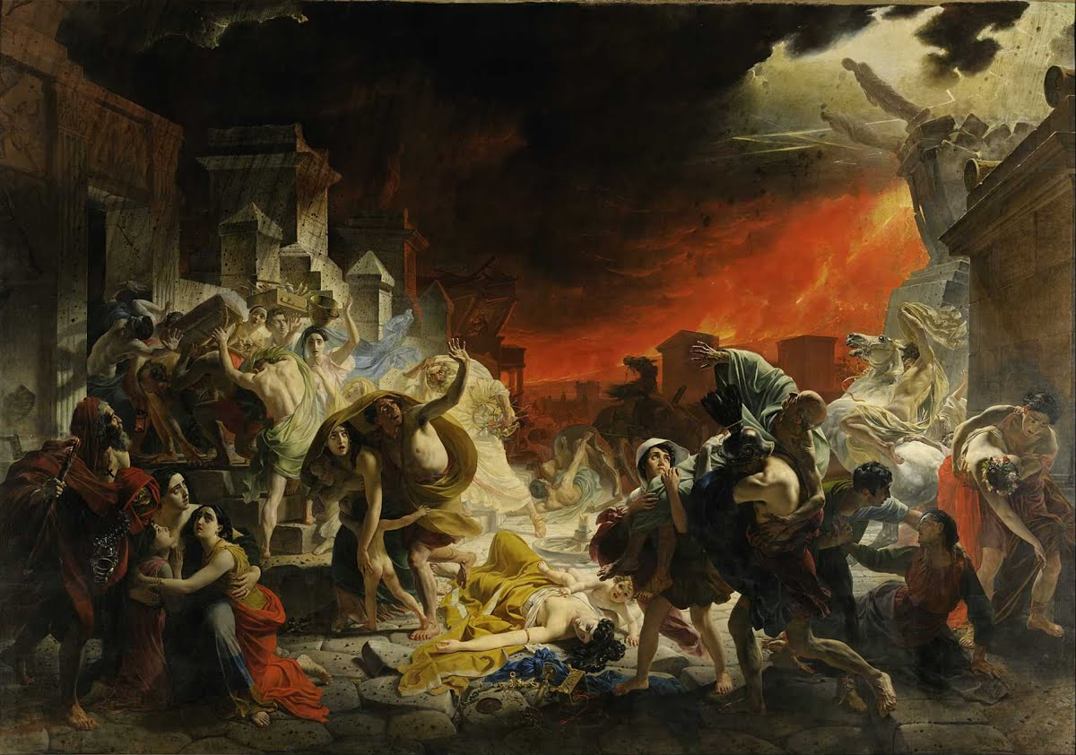
Karl Bryullov, ‘The Last Day of Pompeii’, 1830-33

Slide 13
Consolidation
Create a revision cue card for Romanticism.
Homework:
Complete essay – due next week.

